Slide 1
PAYMENT SYSTEM
Barclays Post Grad Induction
Group : PB1B

Slide 2
Team Members
Himanshu Tiwari – Team Leader
Khushi Singh
Komal Khator
Mukul Pahuja
Neha Pal
Padmini Yadav
Sai Krishna
Keshav Jagdamni
Saurabh Ashutosh

Slide 3
Application Overview
Payment systems are tools designed to make monetary and other financial transactions easier to clear and settle.
This application enables account holder to pay their electricity or mobile bills.
This application has mail provision. (facility to send notification about the new bill, bill status like is it pending or success to account holder via Email.)

Slide 4
Database Structure
Account
Account Transaction
User
Bills
Master billers
Registered Billers
Role

Slide 5
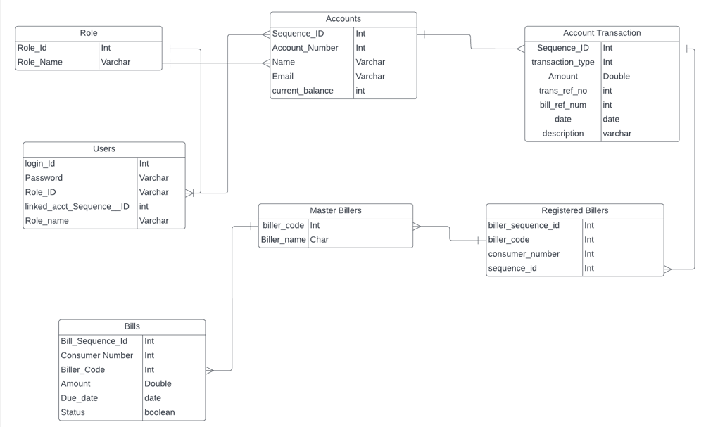
Entity-Relationship Diagram

Slide 6
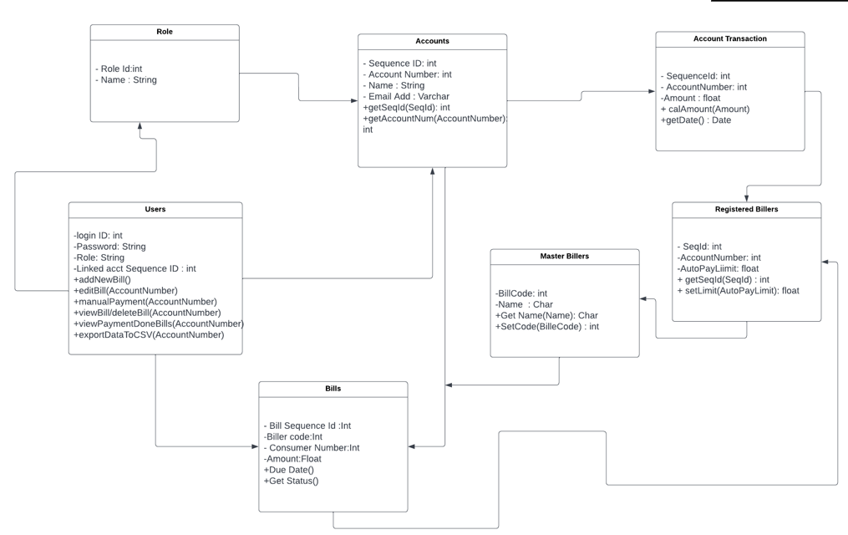
Class Diagram

Slide 7
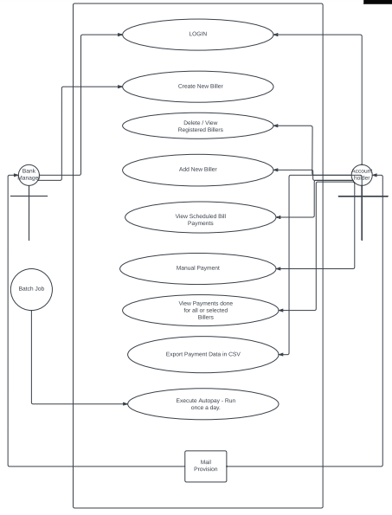
Use Case Diagram

Slide 8
Features
Account Holder
Subscribe a new biller
View list of all billers
View uploaded bills and scheduled payment
Manual Pay
View Past Payment details
Export all payments done into CSV

Slide 9
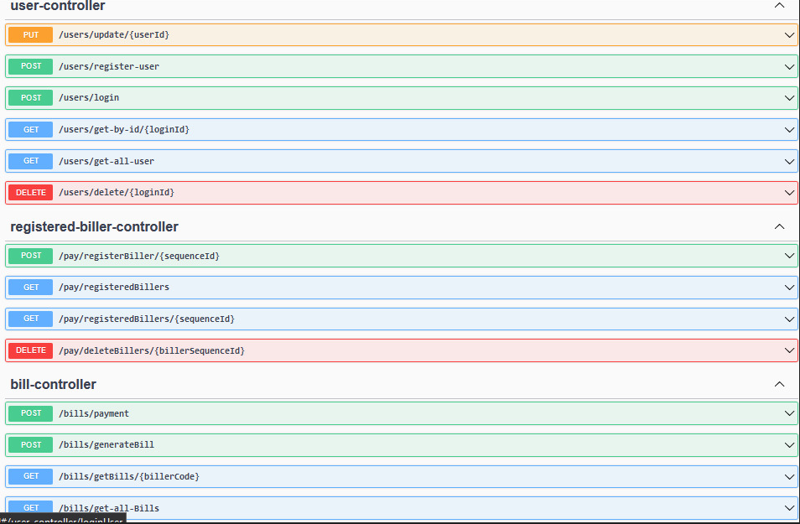
Swagger UI :

Slide 10
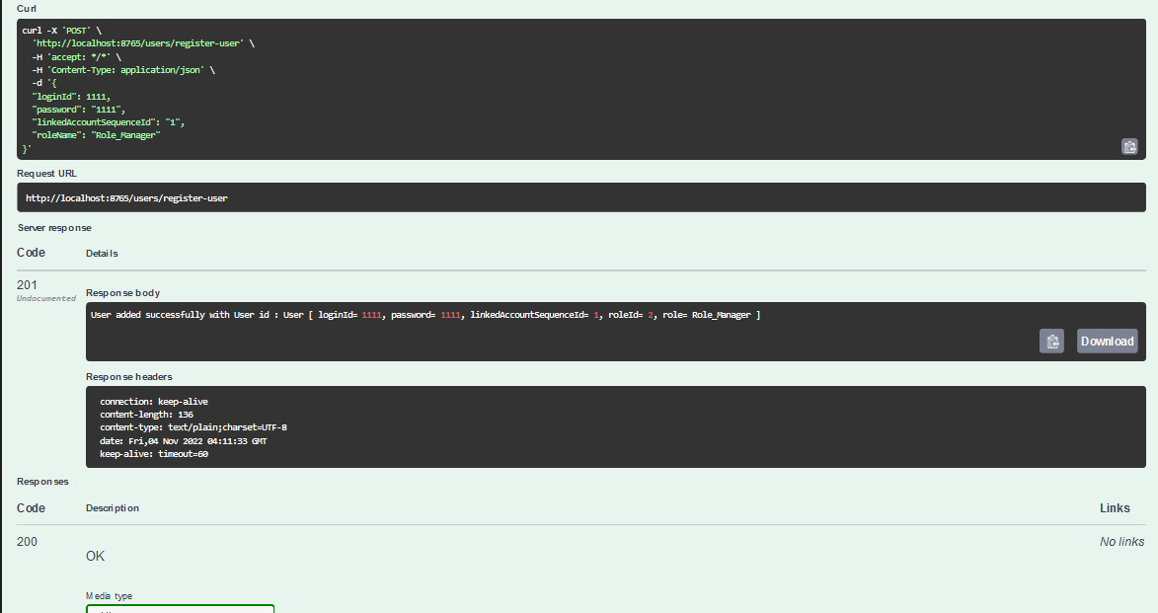
User Registration:POST API http://localhost:8900/users/register-user

Slide 11
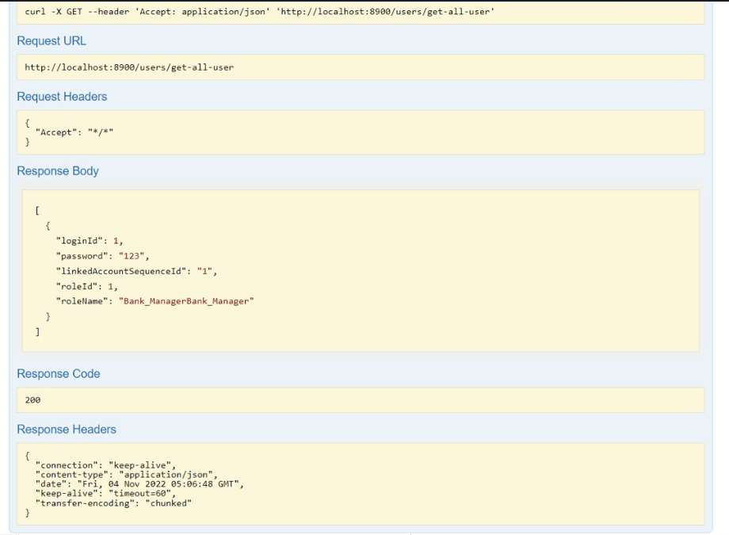
Get all user: GET API http://localhost:8900/users/get-all-user

Slide 12
Features
Bank Manager
Add New Bill
Manage Master Biller List
Update Bills
View All Bills
Email Notification to Account holder

Slide 13
Assumptions
Bank Manager and Account Holder already exists.

Slide 14
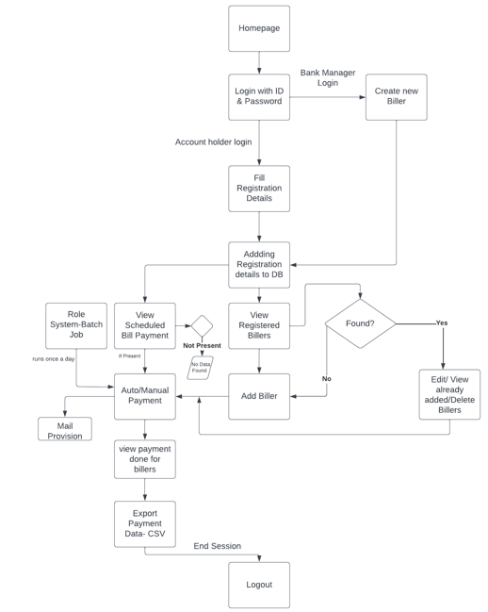
Architecture of the System

Slide 15
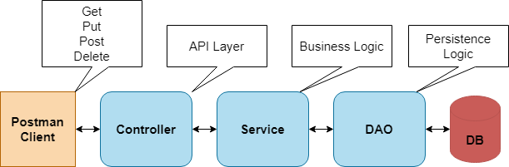
Implementation of the System

Slide 16
The Process
Requirement analysis –
Gathered all the requirements for payment system like the system roles and what kind of operations are going to be performed by each entity.
2. Technical Design discussion –
1. Use case Diagram
2. Class Diagram
3. Database model
4. System Architecture

Slide 17
The Process
3. Designing Project Structure and Entities –
Here Entities created using the hibernate.
4. Implementation of API -
Designed and Tested API using the postman client.
5. Creating Unit tests –
Using Junit created the test cases in spring boot application
6. Updating the Repository
Updating the git repository.

Slide 18
Additional enhancements
Email notification on bill generation and bill payment.
Manual bill payment.
Integrating all API’s with swagger.

Slide 19
Project Dynamics
Team member 1:
Worked on Swagger Integration and Implementation of Get all registered billers.
Team member 2:
Designed User Login, implementation of Registered user.
Team member 3:
Created user entity and user service for Get all users.
Team member 4:
Done the part of Adding New biller API to the master biller.
Team member 5:
Keeping the all bill payment records in transaction table and manual payment method implementation.

Slide 20
Project Dynamics
Team member 6:
Worked on Account holder part to view the list of billers.
Team member 7:
Done the part of converting the payment details to CSV file.
Team member 8:
Account holder can View uploaded bills and scheduled payment.
Team member 9:
Documentation Part of Project as well as entity creation and implementation of triggers.

Slide 21
Lessons Learned
Lesson 1: Agile Work Environment helps to manage the time for working on individual module of project.
Lesson 2: Defining the team and the process for decision-making.
Lesson 3: Set goals that can be achieved

Slide 22
Product Demo
Now we will demonstrate the full working of our application – Payments Systems.

